Slide 1
BookStore
Group 3

Slide 2
Our Team:
Group 3 – T5.2308.M0:
1
Pham Huu Nam Anh Student1501062
2
Vuong Huu Thang Student1501300
3
Tran Vinh Quang Student1501274
4
Nguyen Thanh Nghia Student1477169

Slide 3
Pham Huu Nam Anh
Register-Login System

Slide 4
Login and Register
Admin and User
Database: User
Permission: Login and Register, book user

Slide 5
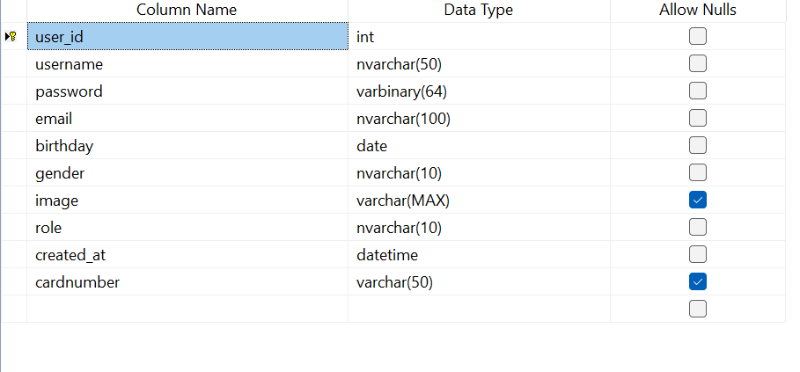
Database User

Slide 6
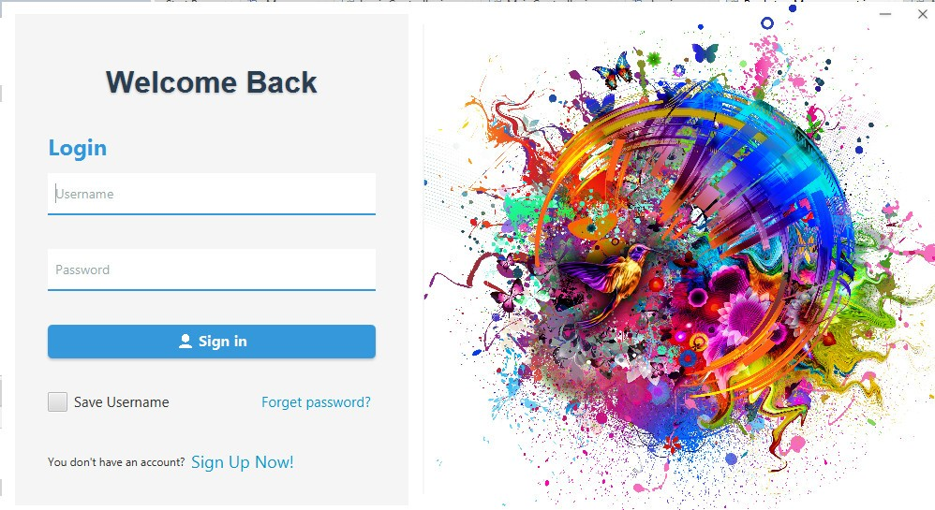
Login Form
Login includes user and administrator accounts

Slide 7
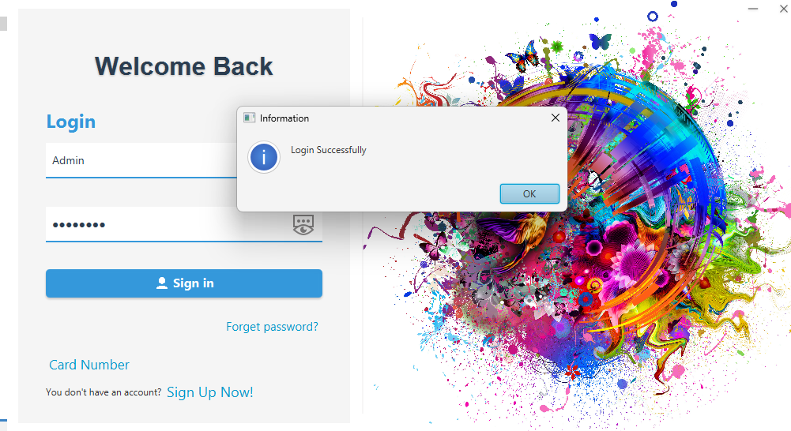
Successful login will display the message Login Successful

Slide 8
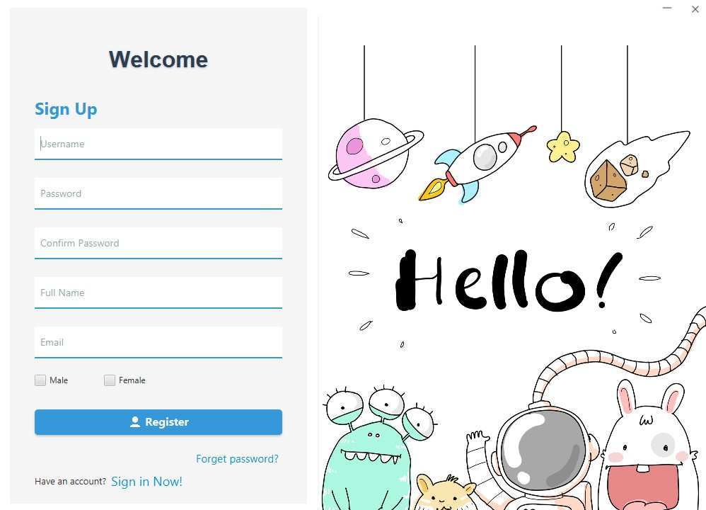
Register

Slide 9
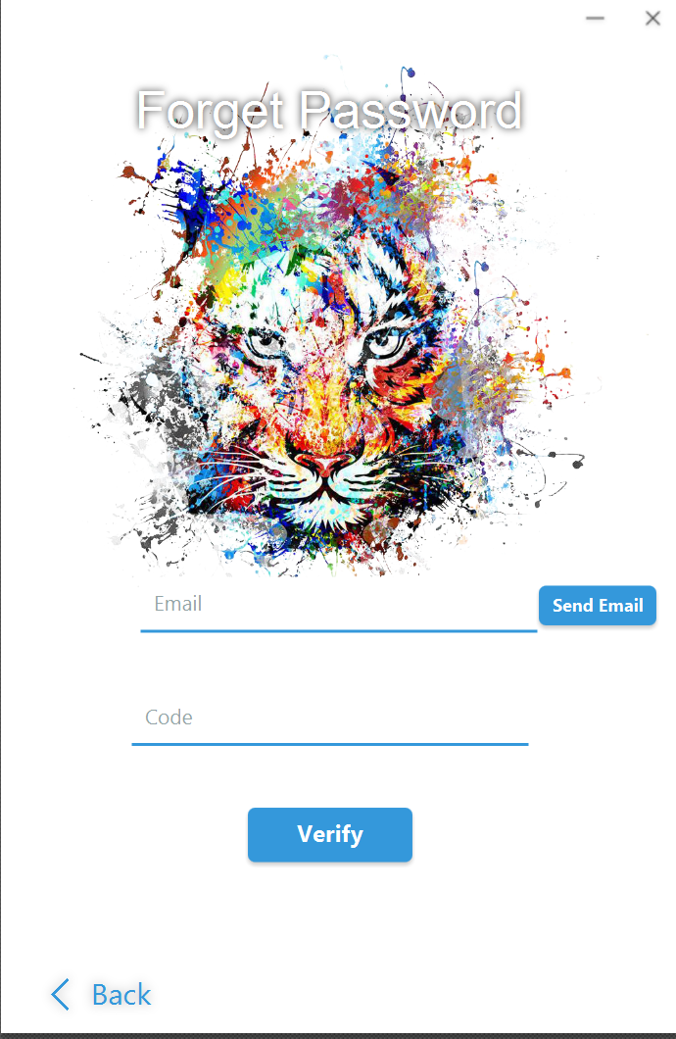
Forget Password

Slide 10
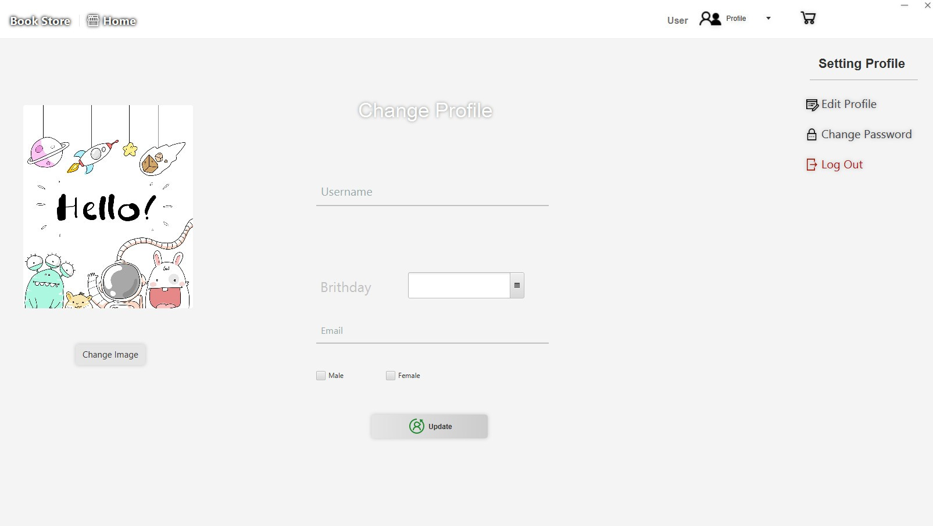
User Profile

Slide 11
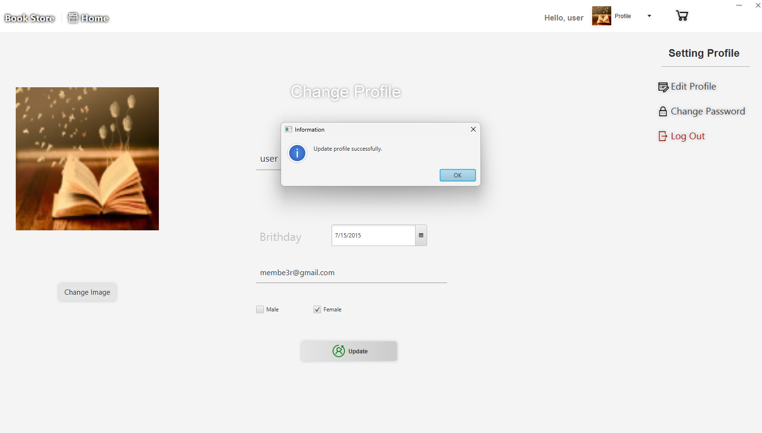
User Profile

Slide 12
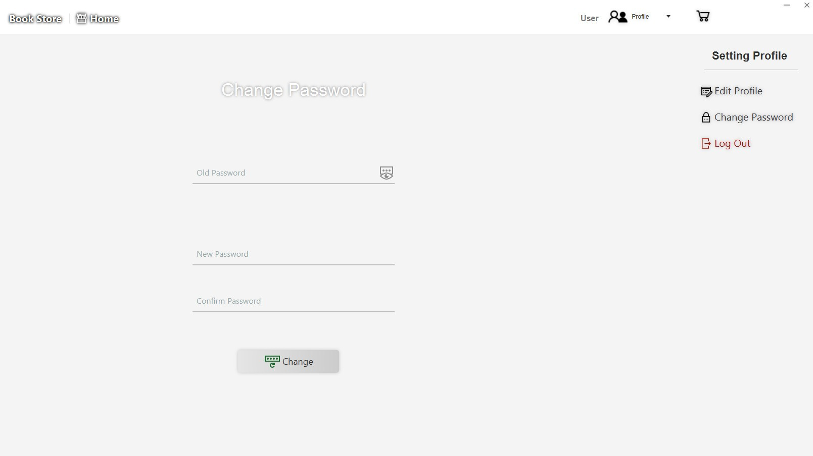
User Profile

Slide 13
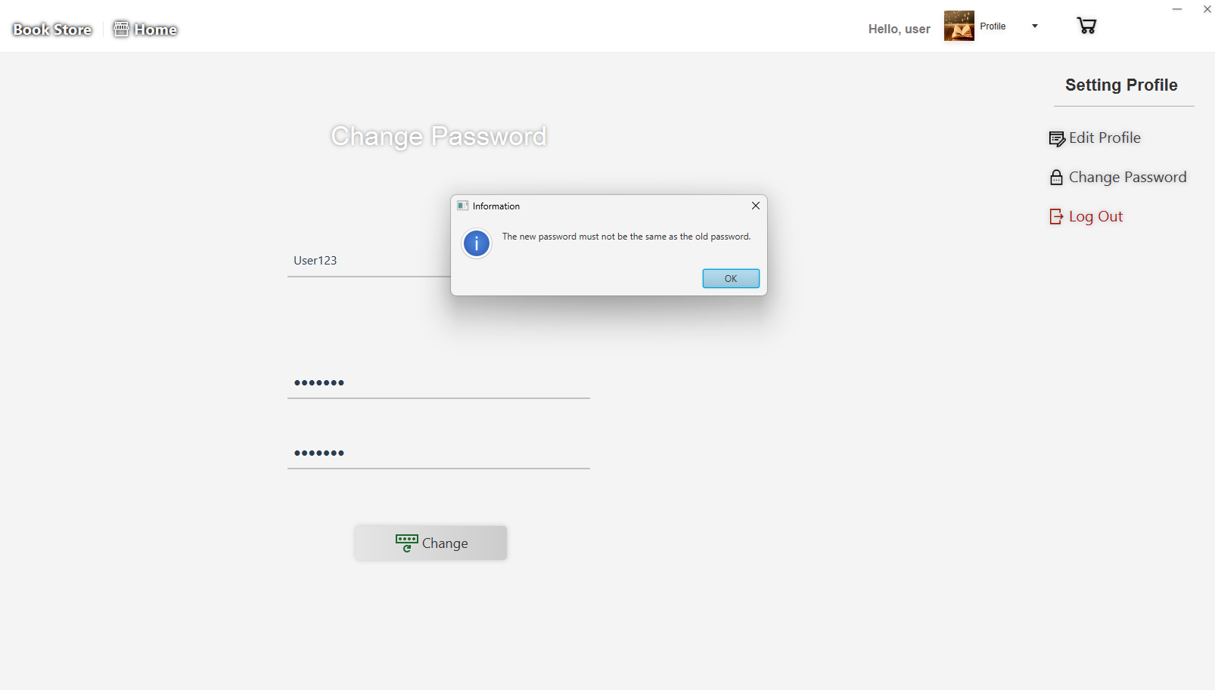
User Profile

Slide 14
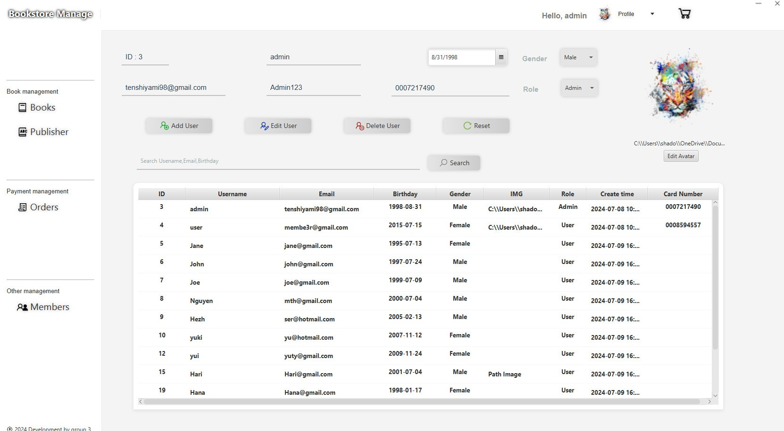
Edit User By Admin
On this user management page we can add, edit and delete users

Slide 15
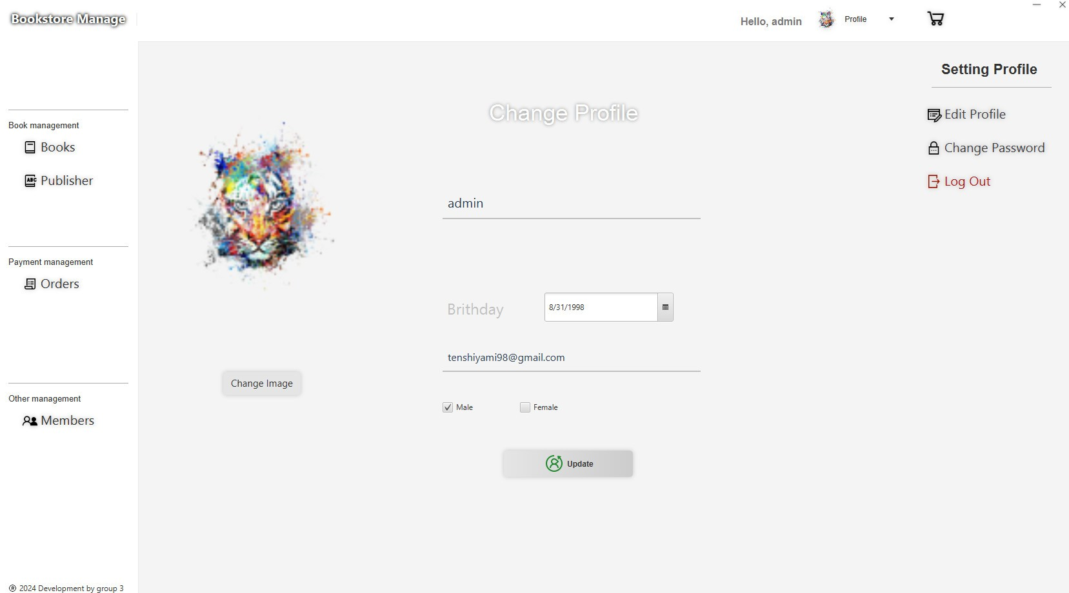
Profile Admin

Slide 16
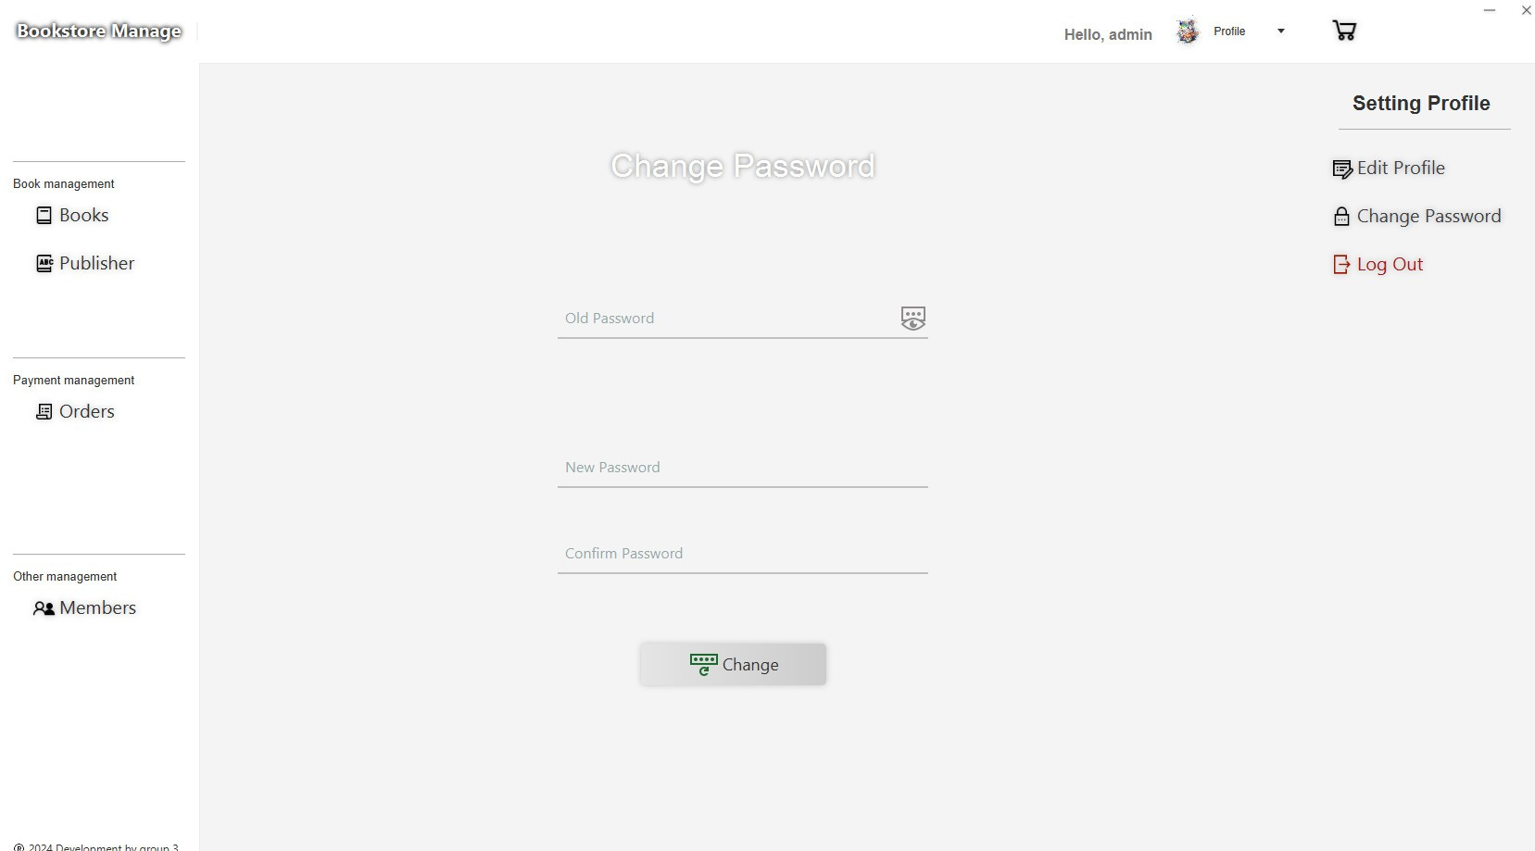
Profile Admin

Slide 17
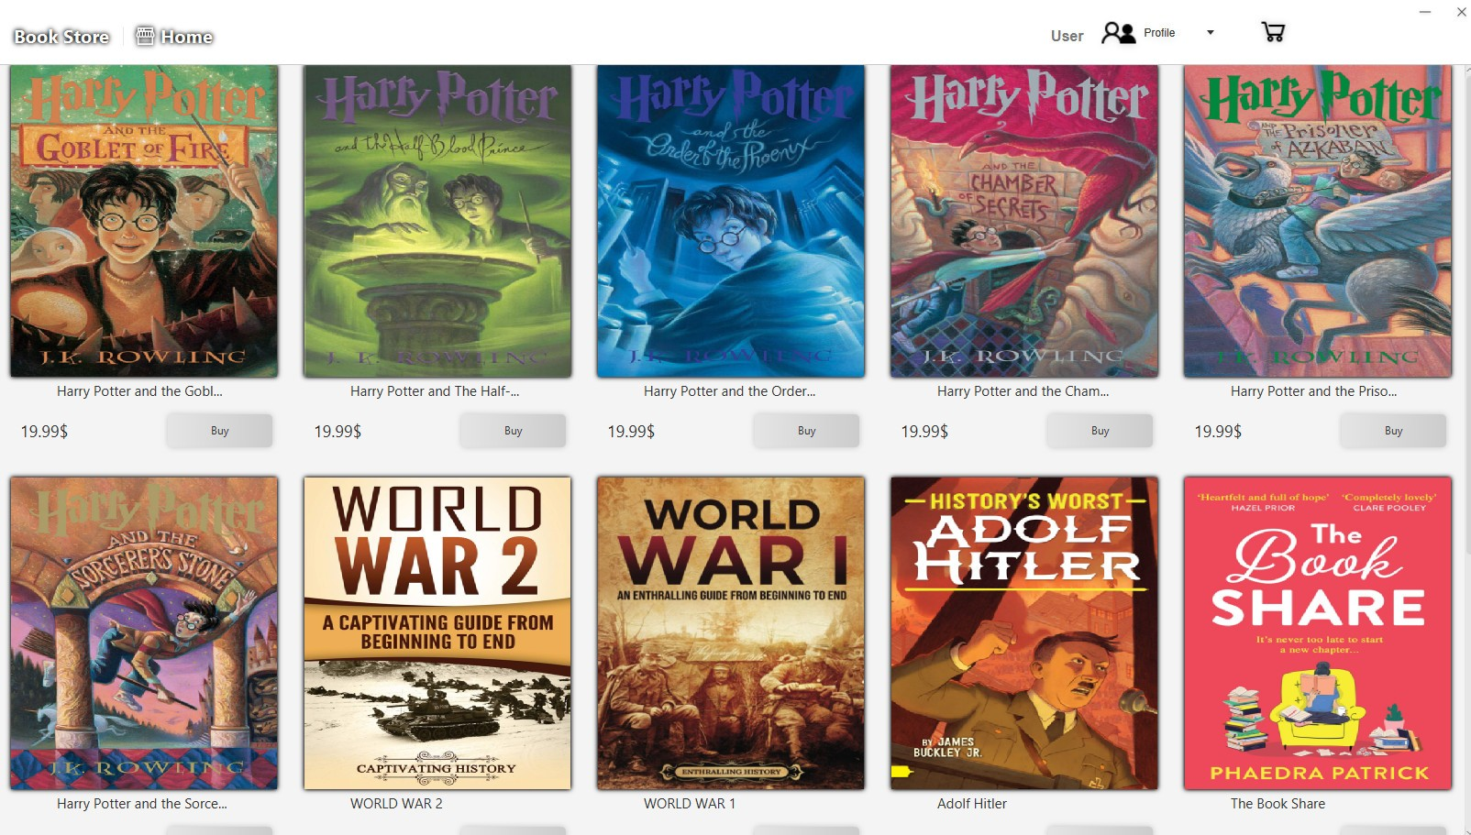
Book Reviews (User) List Book Available

Slide 18
Vuong Huu Thang
Books-Book Review

Slide 19
Books and Book Review
Admin and User
Database: Book
Permission: Book admin

Slide 20
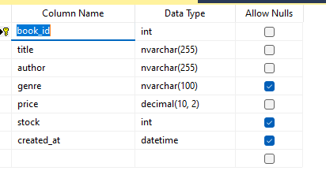
Database Book

Slide 21
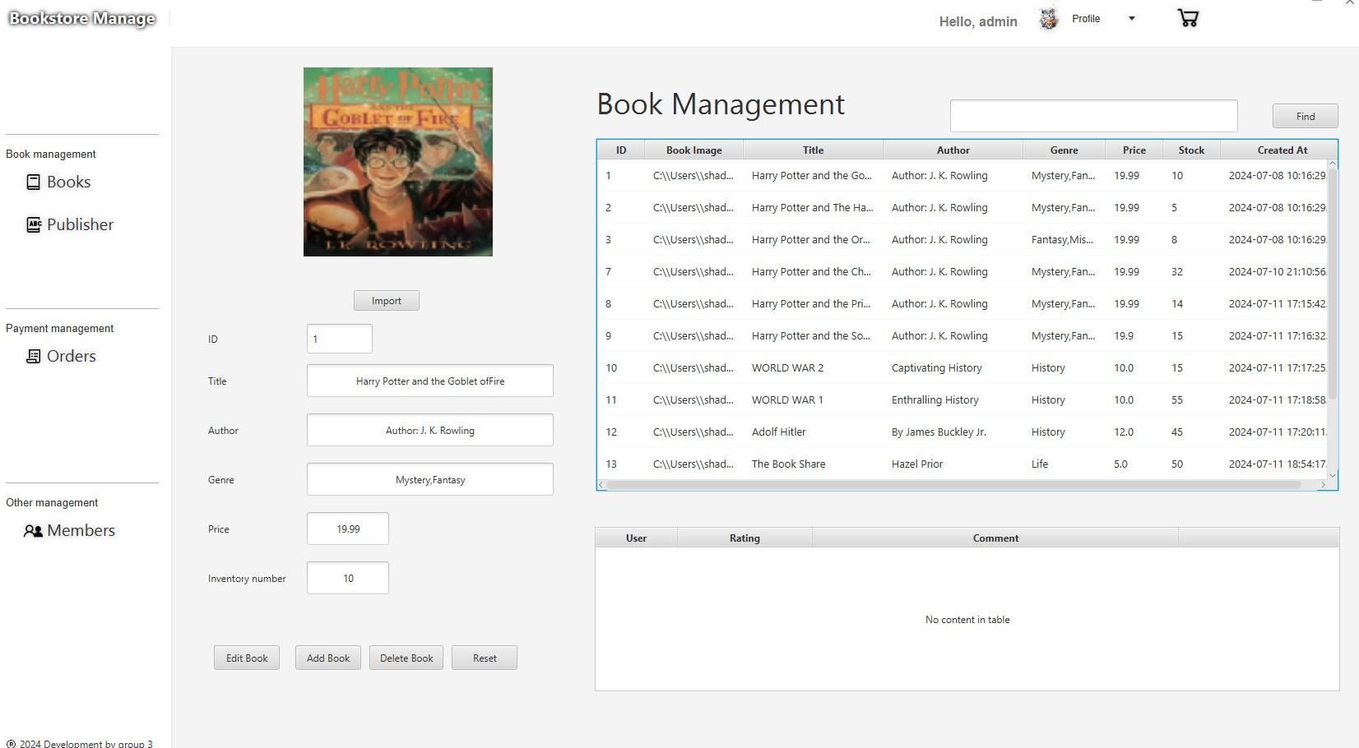
Book Management (admin)

Slide 22
Nguyen Thanh Nghia
Payment-Shopping cart

Slide 23
Payment and Shopping cart, Shopping cart items
User
Database: Payment, Shopping cart
Permission:Payment, shopping cart

Slide 24
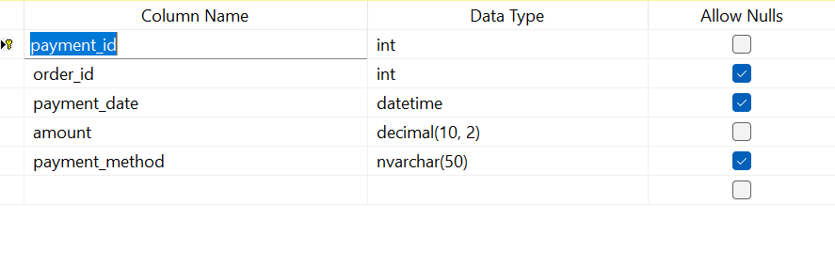
Database Payment

Slide 25
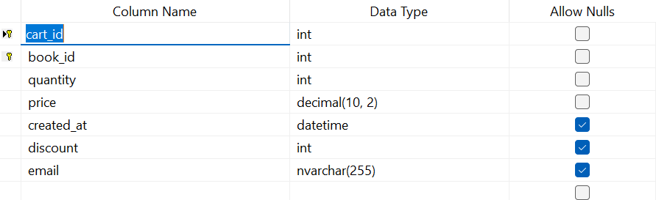
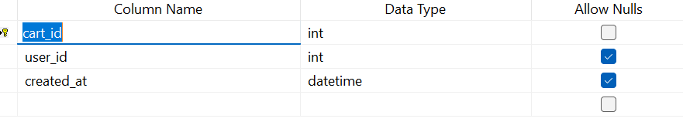
Database Shopping cartShopping cartItems

Slide 26
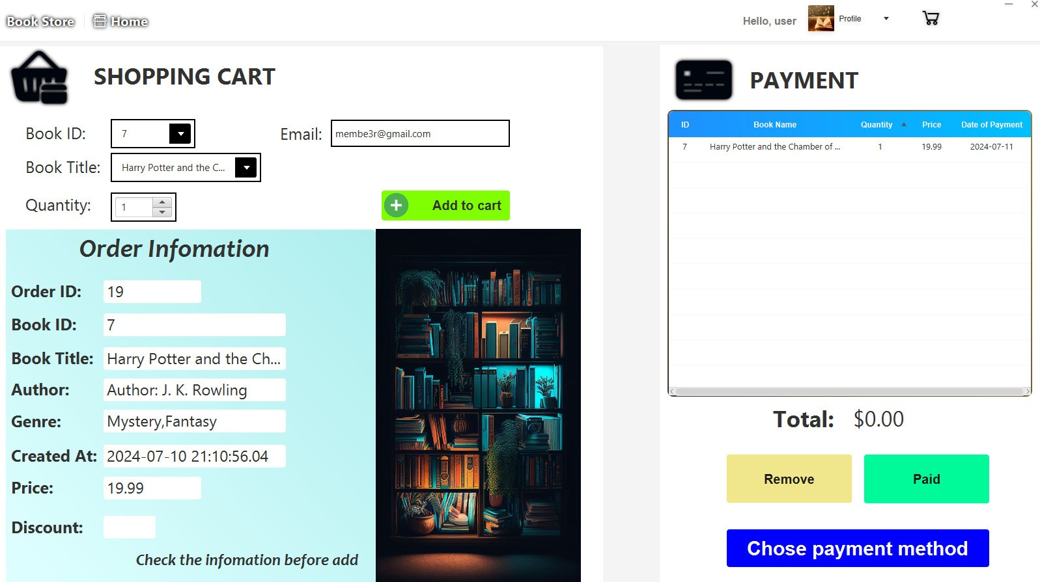
BOOKS SHOPPING

Slide 27
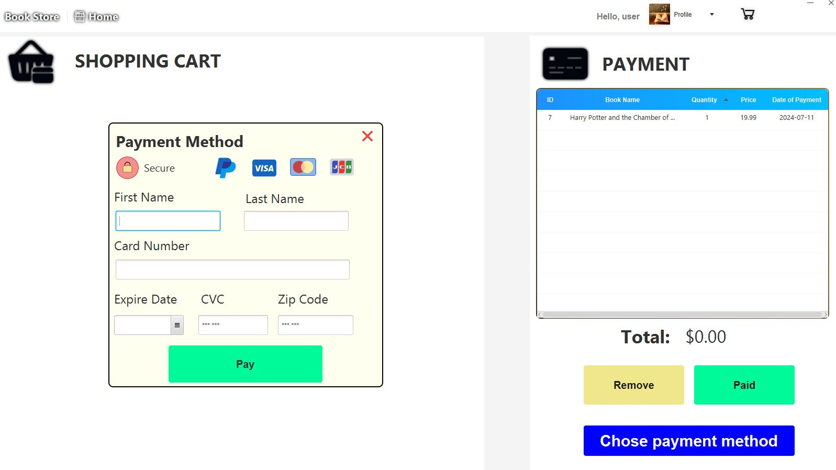
Card check

Slide 28
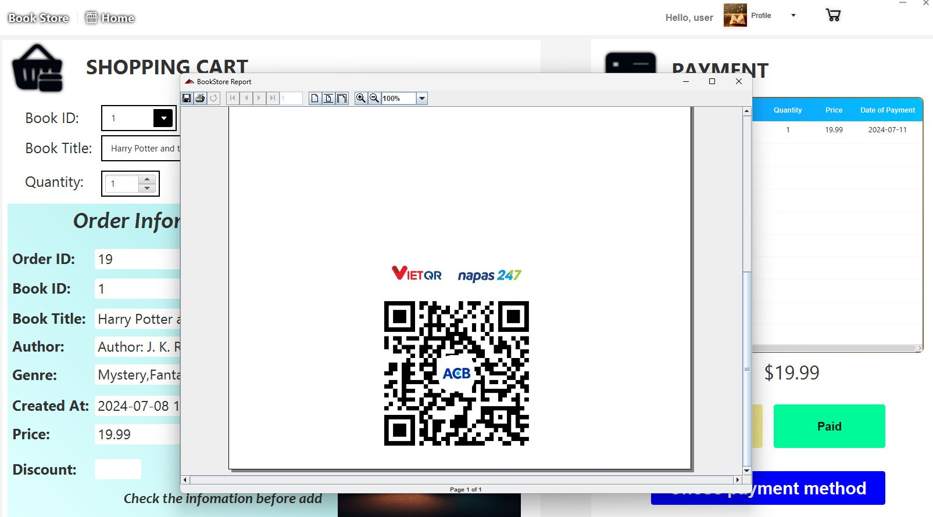
QR CODE

Slide 29
Tran Vinh Quang
Publisher-Order

Slide 30
Publisher and Order
Admin
Database: Publisher, Order, Orderdetail
Permission: Publisher, Order

Slide 31
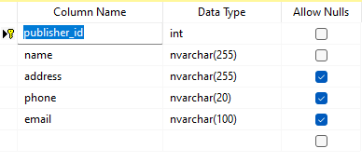
Database Publisher

Slide 32
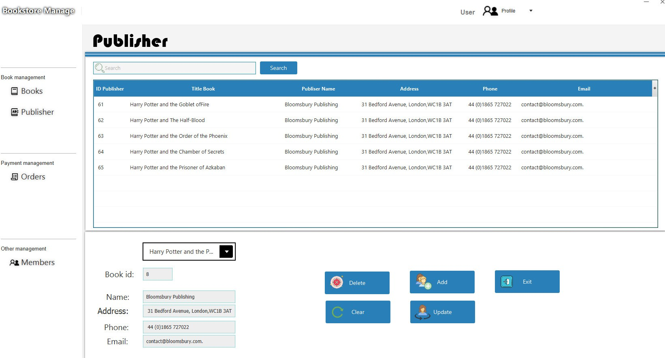
Manage Publisher
On this publisher management page we can add, edit, delete publishers and assign publishers to books.

Slide 33
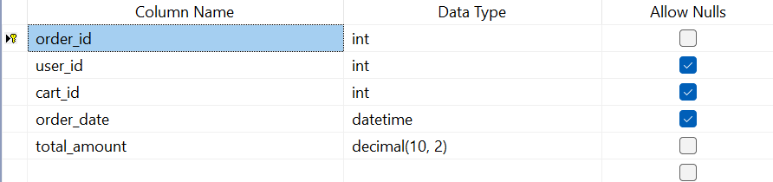
Database Order

Slide 34
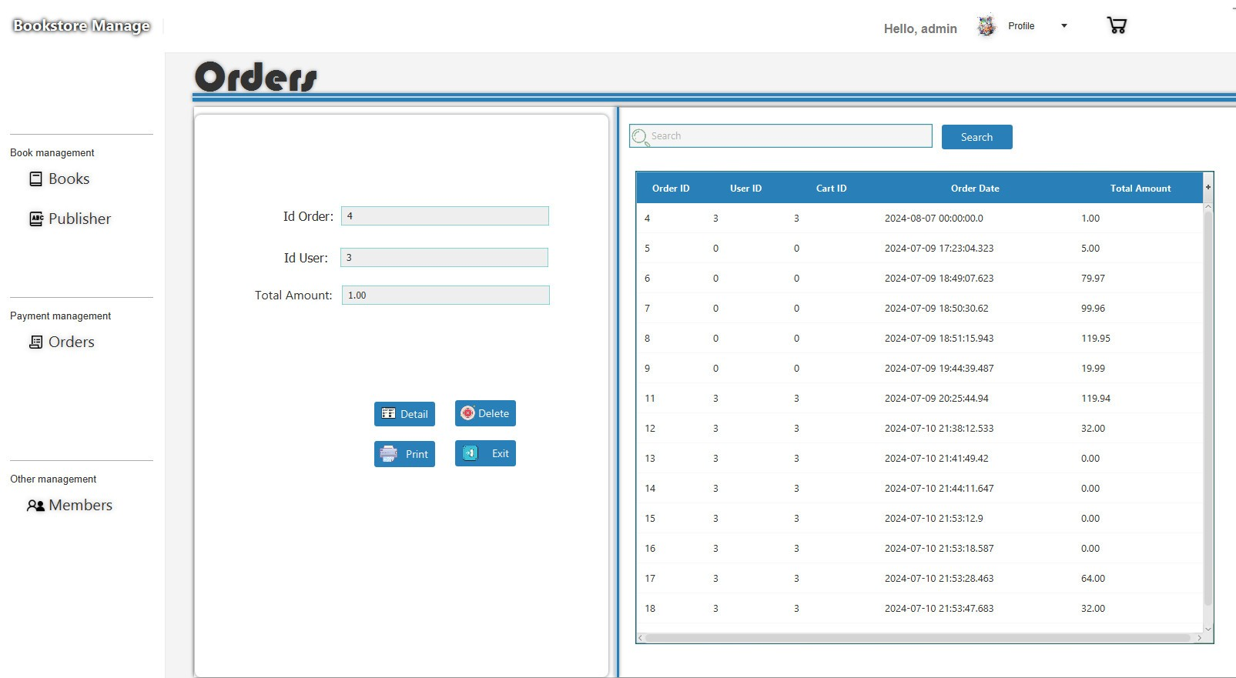
Manage Order
On this order management page we can delete, print, and search orders by order id

Slide 35
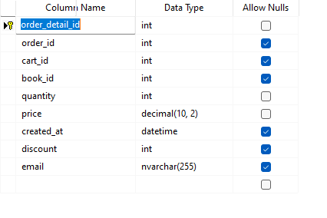
Database Orderdetail

Slide 36
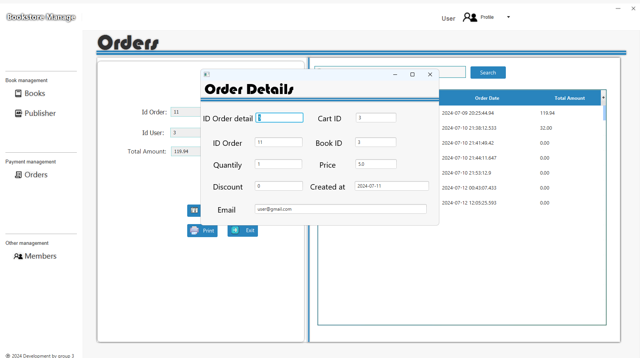
Orderdetail

Slide 37
Thank you for listening!!

